Slide 1
AC297r Fall 2019
Mid-term Summary
Optimal Real-time Scheduling for Black Hole Imaging
EHT Group: Queena, Shu, Yiming
Advisor: Cecilia

Slide 2

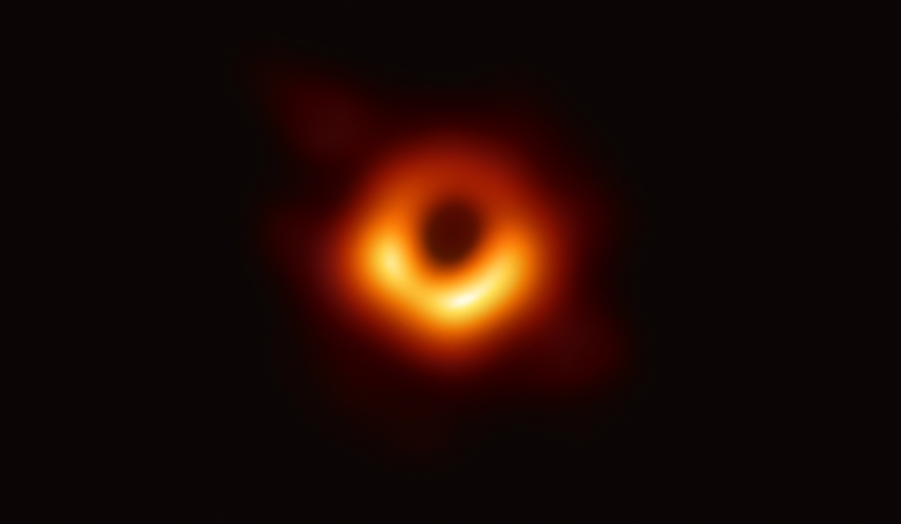
Background
The Event Horizon Telescope is an international collaboration capturing images of black holes using a virtual Earth-sized telescope.

Slide 3
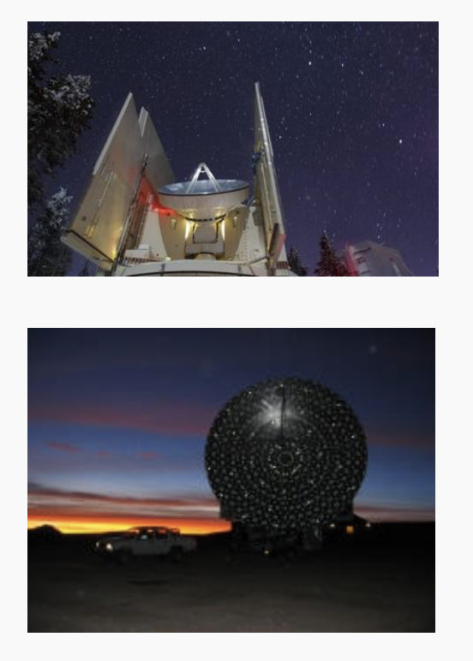
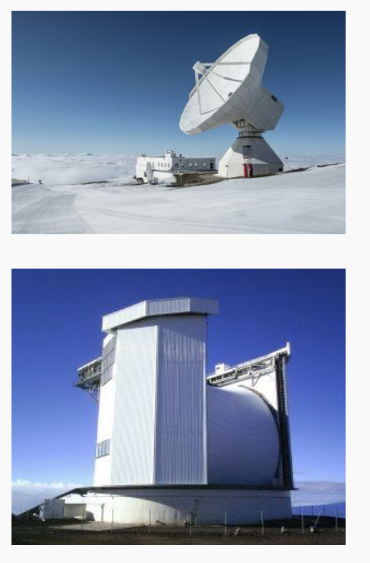
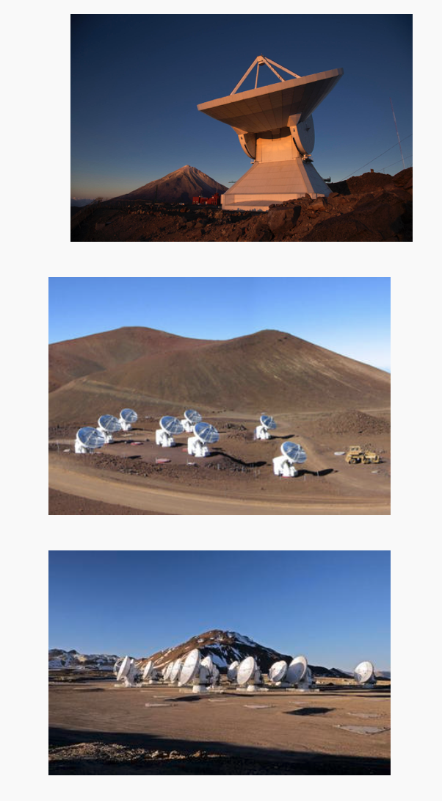
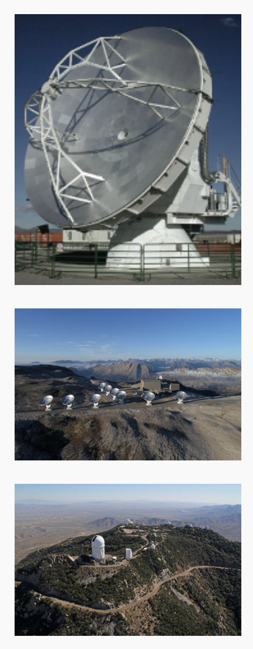
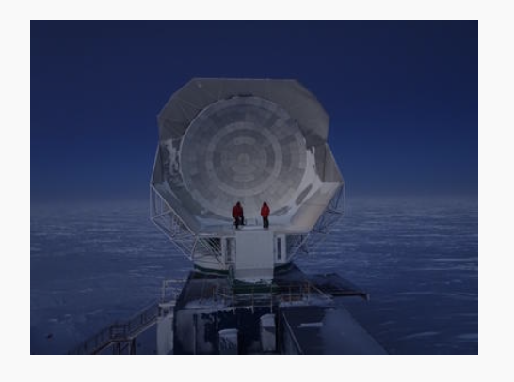
Introduction

Slide 4
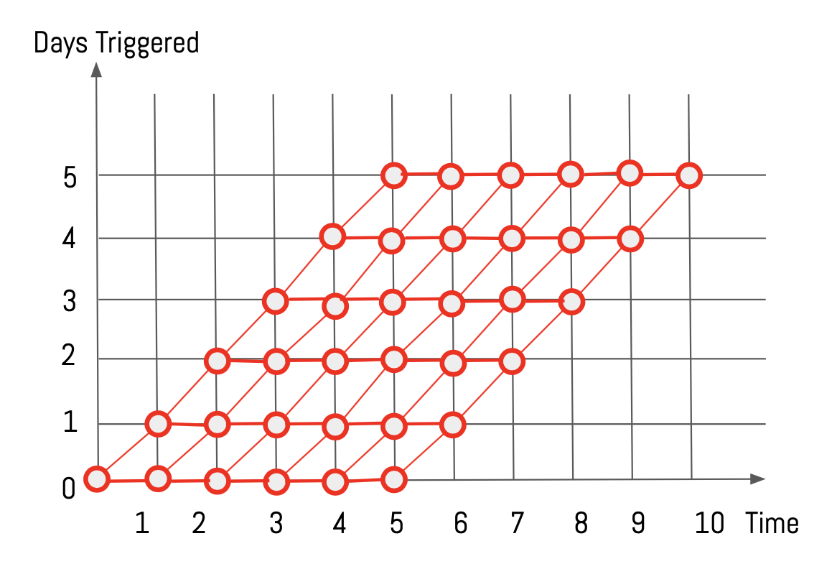
Problem Statement
We are going to build a model that can:
In total, choose 5 days from a 10-day window
On each day, determine the optimal strategy for future remaining days
If possible, provide a confidence level on its suggestion
Also provide the second optimal strategy

Slide 5
Motivations
Improve the decision making process
Increase the chance of capturing the black hole

Slide 6
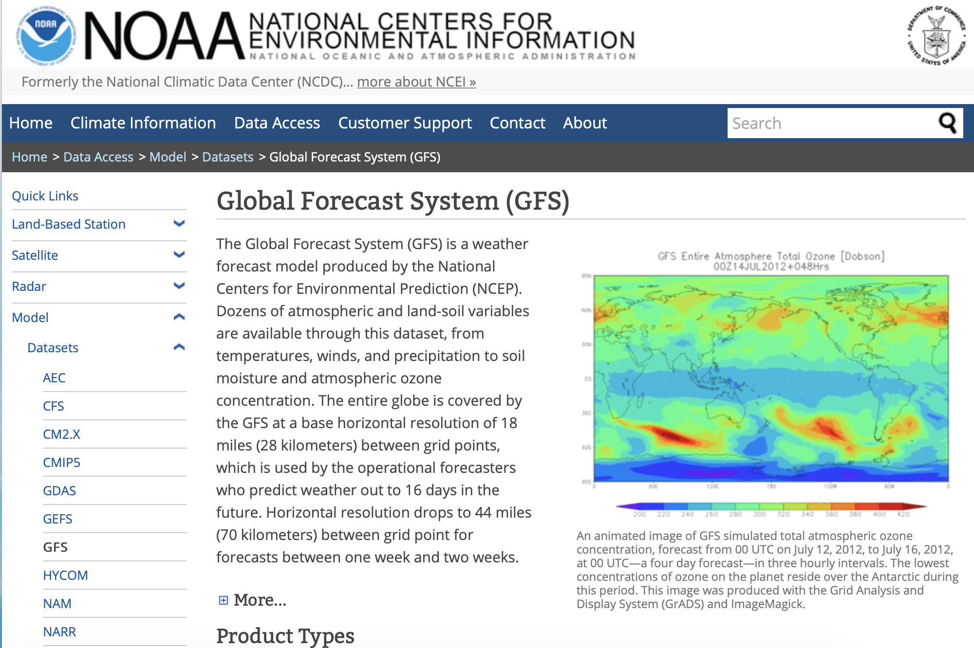
Data Source
GFS provides:
Atmosphere’s condition
Layer-by-layer
All over the globe
We pull data every 6 hours specifying:
Longitude
Latitude
Altitude

Slide 7
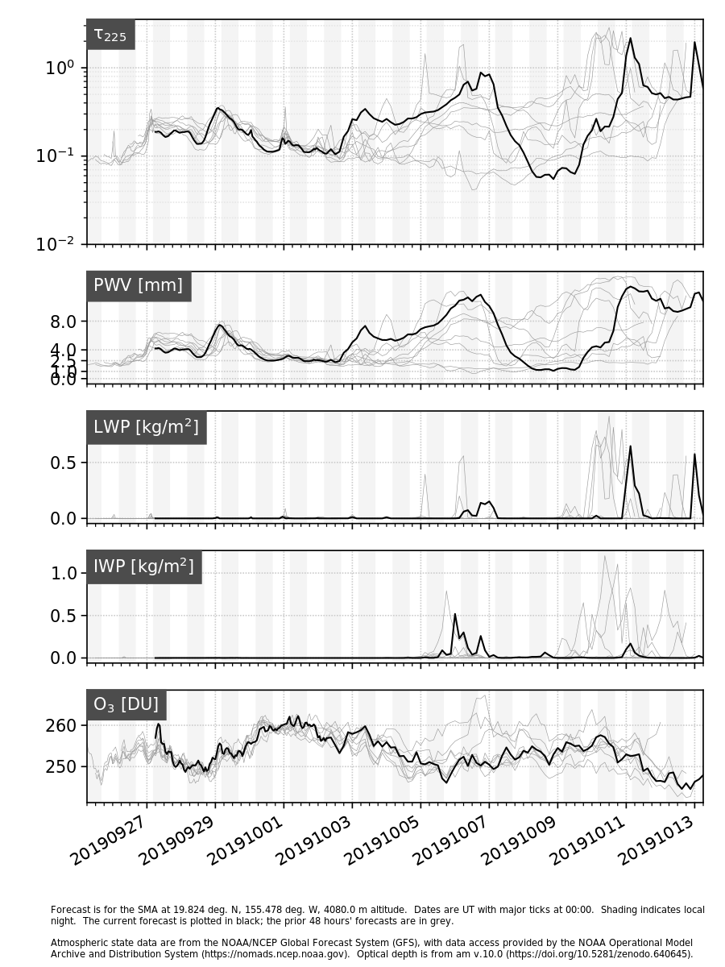
EDA
Every 6 hours, we get 16-day atmosphere forecast from GFS.
First 5-day forecast is pretty accurate.
Variables: Tau_225(absorption directly above head, the lower the better), PWV, LWP, IWP (amount of water in different forms), O3

Slide 8
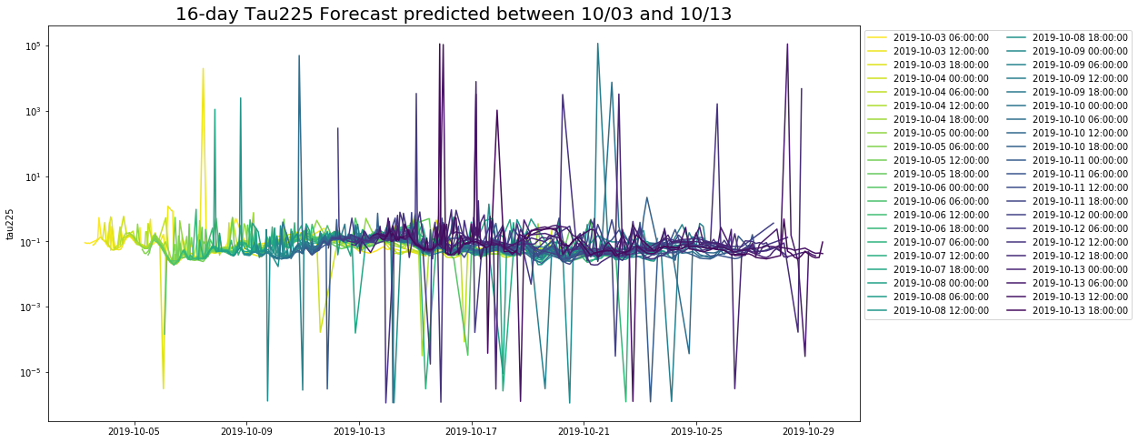
EDA
Spikes
= outliers?

Slide 9
Model Design
Reward Function
2. Uncertainty Measurements
3. Optimization
4. Model Evaluation
f(i)
reward at a single telescope i.
F(f(i))
Total rewards for
all telescopes
Measure performance
based on real weather afterwards.
Compare with:
Best path afterwards
Human-made decision

Slide 10
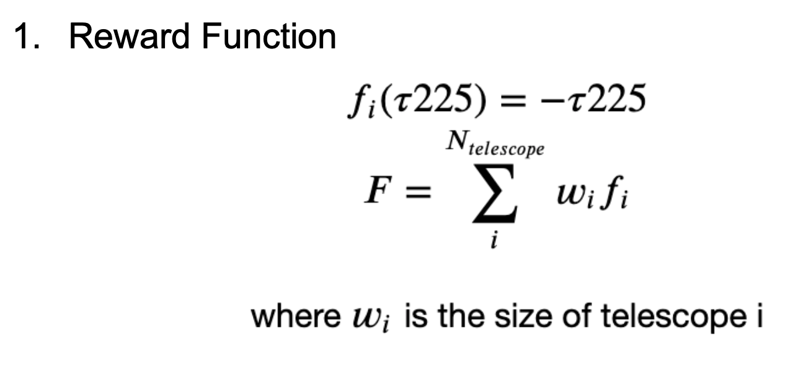
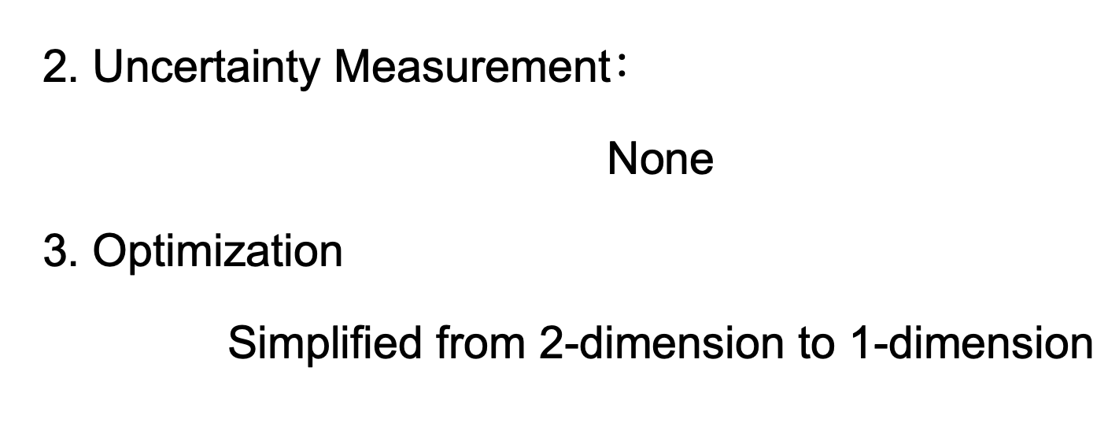
Baseline Model

Slide 11
Example - optimization
Day1 | Day2 | Day3 | Day4 | Day5 | Day6 | Day7 | Day8 | Day9 | Day10
19.03 | 13.93 | 16.24 | 16.38 | 18.80 | 12.99 | 17.02 | 19.03 | 18.81 | 14.06

Slide 12
Example
Day1 | Day2 | Day3 | Day4 | Day5 | Day6 | Day7 | Day8 | Day9 | Day10
19.03 | 13.93 | 16.24 | 16.38 | 18.80 | 12.99 | 17.02 | 19.03 | 18.81 | 14.06

Slide 13
Example
Day1 | Day2 | Day3 | Day4 | Day5 | Day6 | Day7 | Day8 | Day9 | Day10
19.03 | 13.93 | 16.24 | 16.38 | 18.80 | 12.99 | 17.02 | 19.03 | 18.81 | 14.06
Day2 | Day3 | Day4 | Day5 | Day6 | Day7 | Day8 | Day9 | Day10
18.82 | 11.04 | 19.07 | 13.06 | 14.46 | 15.90 | 18.37 | 16.98 | 18.30

Slide 14
Day1 | Day2 | Day3 | Day4 | Day5 | Day6 | Day7 | Day8 | Day9 | Day10
19.03 | 13.93 | 16.24 | 16.38 | 18.80 | 12.99 | 17.02 | 19.03 | 18.81 | 14.06
Day2 | Day3 | Day4 | Day5 | Day6 | Day7 | Day8 | Day9 | Day10
18.82 | 11.04 | 19.07 | 13.06 | 14.46 | 15.90 | 18.37 | 16.98 | 18.30
Day3 | Day4 | Day5 | Day6 | Day7 | Day8 | Day9 | Day10
10.21 | 17.67 | 14.48 | 11.21 | 19.31 | 16.50 | 11.41 | 12.22
Day4 | Day5 | Day6 | Day7 | Day8 | Day9 | Day10
18.97 | 17.30 | 17.83 | 17.42 | 14.64 | 16.43 | 12.25

Slide 15
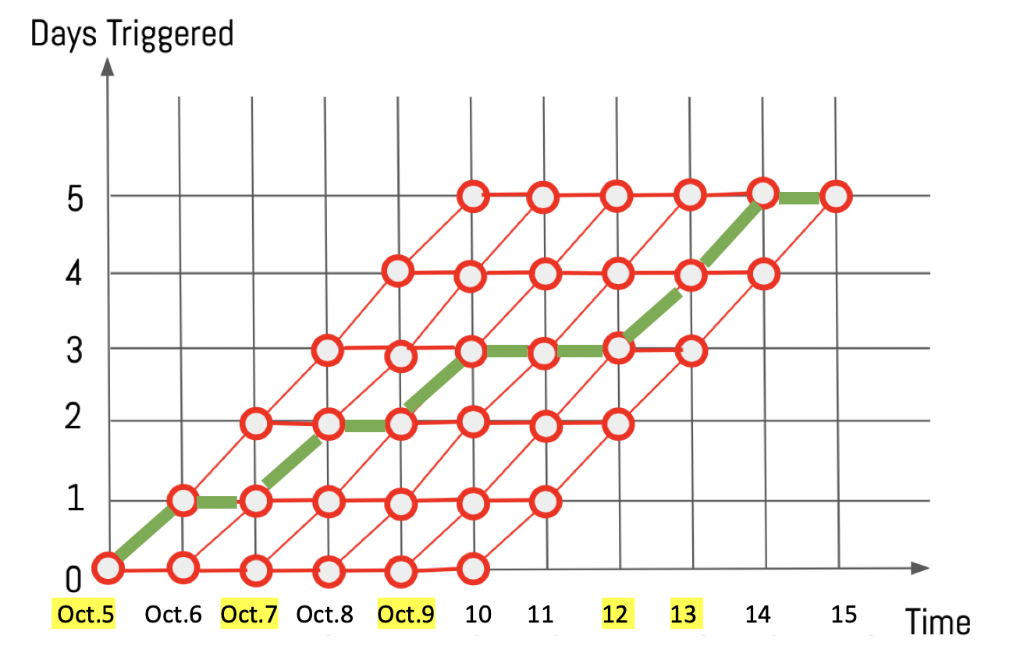
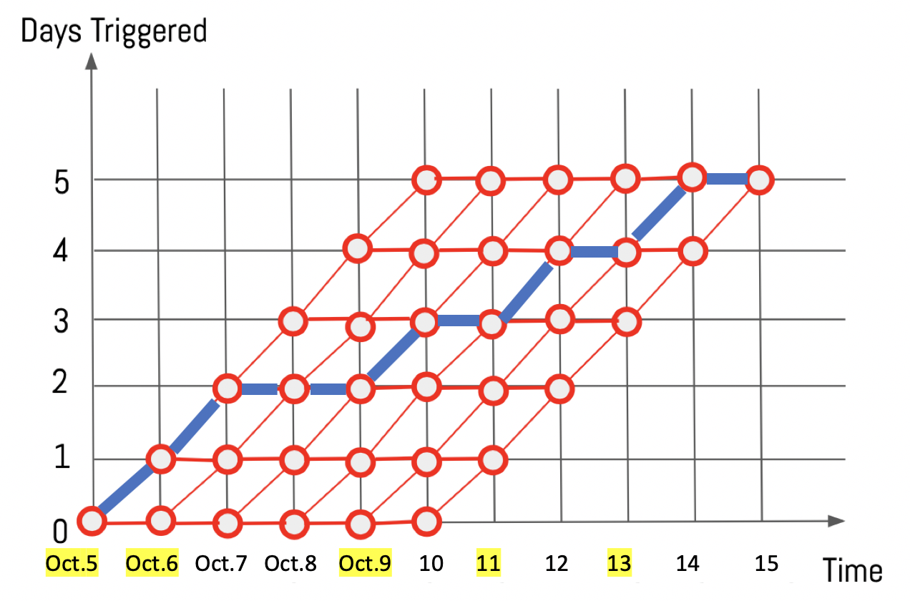
Baseline Model - evaluation
Choose 5 days From Oct.5 - Oct.14, 2019
Path suggested by Baseline
Ground-truth Best Path Afterwards
Total Reward: - 4,260,444
Total Reward: - 54,244

Slide 16
Next Steps
Adding Uncertainty Measurement
Possible Directions:
Discount Factors
Probabilistic Distribution
….

Slide 17
Final Deliverables
A python package implementing an optimal real-time scheduling algorithm
Proper documentation explaining the algorithm.
Nice to have: visualization of the path
Atmosphere prediction
Strategies

Slide 18
Timeline
Date | Tentative Schedule
10/18/2019 | Midterm Presentation Short Report to EHT EDA Baseline Model with evaluation
10/25/2019 | Second meeting with EHT Get to understand files even more Brainstorm uncertainty measurement
11/1/2019 | Experiment with different reward functions Incorporate uncertainty into the model
11/8/2019 | Third meeting with EHT Experiment with different uncertainty methods

Slide 19
Timeline
11/15/2019 | Milestone 3 Presentation Short report to EHT Find ways to incorporate visualization into the output
11/22/2019 | Build visualization around the output Build GUI
12/6/2019 | Finalize the advanced model Get ready to ship the package
12/9/2019 | IACS showcase
12/11/2019 | Final presentation
12/12/2019 | Final deliverables (slides, blog, self- and peer- evaluations)

Slide 20
Thank you!
10.15.2019

